Slide 1
Reference-based Alignment using Seeds
Project_2
GITHUB Link: https://github.com/KristopherMoore/CS-499-Project-2
Based on: https://www.ncbi.nlm.nih.gov/pmc/articles/PMC4695832/
Jennie Ryckman jtr93@nau.edu
Kristopher Moore krm363@nau.edu
Jake Farrar jkf76@nau.edu
Zhaolu Yang zy52@nau.edu
Samantha Muellner shm53@nau.edu
Austin Pederson amp845@nau.edu
Anthony Schroeder as3379@nau.edu

Slide 2
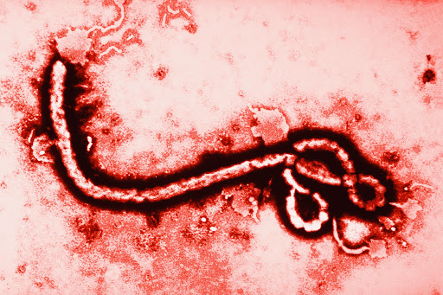
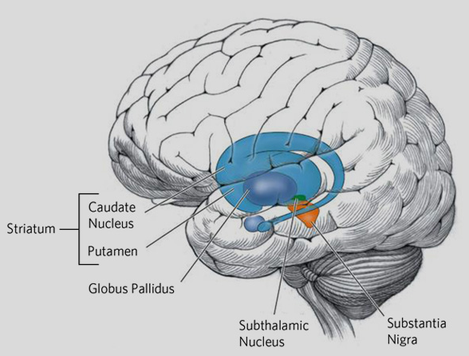
Introduction
Figure 2. Ebola virus
Occurred December 2013 - June 2016
11,310 total deaths
Figure 1. Huntington's Disease
With about 200,000 cases per year
Notes:
In the highly connected of the world today, viruses and bacteria are an all time threat. <Example : ebola, with the outbreak in africa killing 11 thousand people>, So Being able to identify the strain of different bacteria, and viruses is incredibly important to save lives.
Along with identifying pathogens, being able to identify genetically inherited disease is equally as important for finding the optimal treatment.
For example:
Huntington's disease: Is a genetic disorder that causes (a)/(the huntingtin) protein to be malformed making it prone to clump up, and kill cells. This leads to a progressive breakdown of nerve cells in the brain, and eventually death. Currently the only way to detect huntington’s is either through brain scans or a genetic test.
With about 200,000 cases a year, it's important to catch the disease before it Progresses and reduces the quality of life of these individuals.
And although huntington’s can be detected through mass-spectrometry, (and doesn't need to be sequenced to be found), finding genetic variance and analyzing genetics might one day help find a cure to this and other genetic diseases.

Slide 3
Where BioInformatics comes in
Bioinformatics: The study of collecting and analyzing biological data, such as genetic codes.
And is responsible for:
Finding unique enzymes (these same enzymes are responsible for the entire operation of all life!)
This research is used to identify the genealogy of dangerous bacteria, and viruses
Genealogy of humans,
Identifying life threatening illnesses and disease, helping people prevent and delay illness and death
Therefore sequencing genetic material quickly is incredibly important!
Notes:
Bioinformatics: The study of collecting and analyzing biological data, such as genetic codes.
And is responsible for:
Finding unique enzymes (These same enzymes are responsible for the entire operation of all life!)
As discussed before, Identify the genealogy for dangerous bacteria, and viruses.
Finding each person’s Genealogy,
Identifying life threatening illnesses and disease, helping people prevent and delay illness and death
And because of the capabilities of bioinformatics, sequencing Genetic material quickly is incredibly important! And as Sequences can be very large it takes a long amount of time for certain algorithms to process given data, and produce a result.

Slide 4
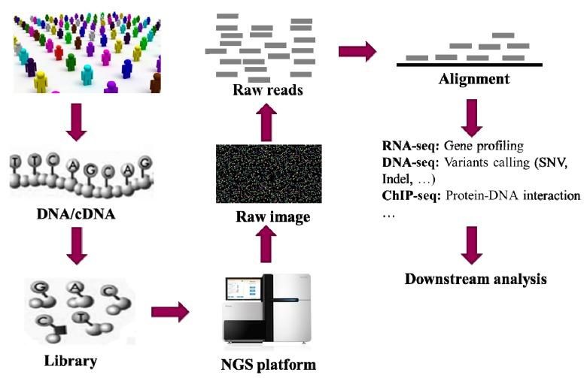
Genetic Sequencing Workflow
NGS workflow: https://www.ncbi.nlm.nih.gov/pmc/articles/PMC4695832/figure/pharmaceutics-07-00523-f001/
Notes:
<Now we know the importance of BioInformatics>, how is it done?
Here are the general steps taken to sequence DNA: (with the New Generation Sequencing(NGS) Machines)
First, DNA extraction,
This is done by taking sample tissue, and extracting DNA (or cDNA).
Making Fragments.
DNA library building,
These fragments undergo PCR(Polymerase chain reaction), which makes many copies of the Fragments.
These copies build the library by amplifying each of the small fragments.
Sequenced through a NGS(New Generation Sequencing) Machine, which captured images
Usually these “sequence Reads” are short and are around 175 to 300 base pairs.
NGS() Machines produce images that are analyzed and a sequence is predicted
These Sequences are used in an Alignment algorithm which attempts to create a complete sequence.
These Alignment algorithms:
Attempt to account for variants detection, methylation patterns profiling (MeDIP-Seq)
protein-DNA interactions mapping (ChIP-Seq),
Work with many short sequences
Genetic variants detection and downstream data analysis.
There are a few different hashing techniques used to generate these seeds:

Slide 5
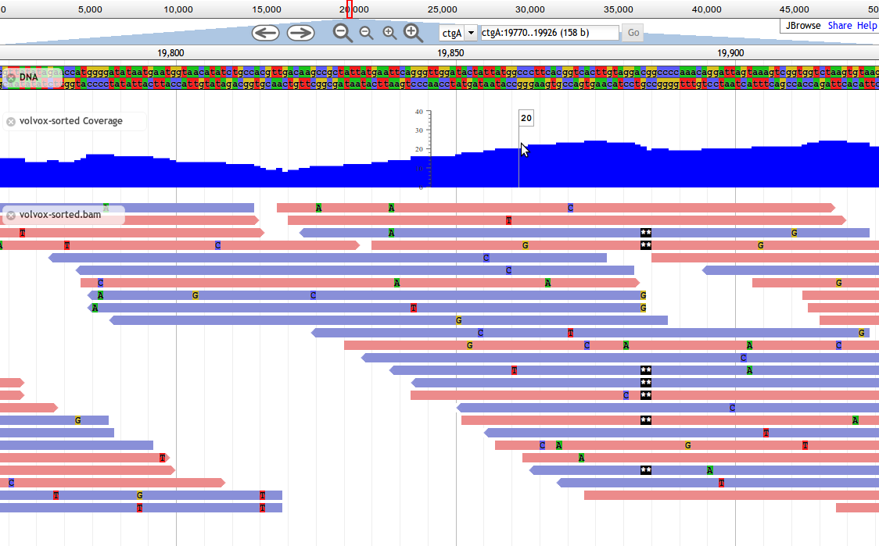
The Problem: Sequence Assembly
Algorithm Need to account for:
Sequence Mutation
Substrate Material(DNA/RNA)
Loops in Original Sequence
Machine Used
Sequence Length Variation
Read Errors
Notes:
Taking the previous Genetically sequencing workflow in mind, The problem we need to solve is to take these different partial sequences, and predict the original sequence.
To do this we need to build an alignment program, that can account for any issues that might arise. These issues might come from, the Machines being used, and the actual behavior of Sequences:
-These NGS machines introduce variance in the FASTA Files/Images that they produce such as:
Sequence length Variation, Ranging from: 300 bp to 40k bp.
Read Errors, as discussed previously in class, machines tend to take pictures with consistent errors of specific sequences
The Substrate Material extracted, such as sequencing DNA or RNA,
Loops in original sequence.
And usually, to account for these different problems is to allow users to enter runtime parameters to account for these different issues.

Slide 6
The problem
The acceleration of sequences being read has been increasingly for the last few years. About X4 each year.
But processing speed has only been ‘doubling’ every 2 years.
Although this can be solved by making the algorithm parallelizable, buying hardware to compensate for this is expensive.
So in order to keep up with these increases of speed, Alignment methods need to be improved to help keep up with these New Generation Sequencing (NGS) machines.
Notes:
Not only do we have to correctly find the correct original sequence as explained on the previous slide, we need to find faster and more efficient ways of doing this.
The acceleration of these NGS Machines have been steadily increasing for the last few years. With an speed X4(Quadrupling) each year.
But, in contrast processing speed has only been doubling every 2 years. (Although there is more to it)
Although this can be solved by making the algorithm parallelizable, buying hardware to compensate for this is expensive.In order to keep up with these increases of speed with current hardware, these Alignment methods need to be improved to help keep up with these New Generation Sequencing (NGS) machines.

Slide 7
Requirements
Take these short sequences and recreate the original sequence.
Needs to be fast.
Take a ‘Small’ amount memory space()
Stretch Goals:
Accurate and Accounts for various read errors:
Read Omission,
Read appendage/addition,
Read mismatch.
Handle loops in original sequence.
Notes:
To reiterate, our Requirements for this project require us to create a system to:
Most importantly Generate proper sequences.
It’s got to Be Fast, to combat the large generation of sequencing data,
And it needs to be able to operate with a ‘small’ amount of memory, as comparing these large sequence’s can consume an exorbitant amount of memory.
Our stretch Goals for this project are:
To account for the various read errors that are associated with the different NGS Machines.

Slide 8
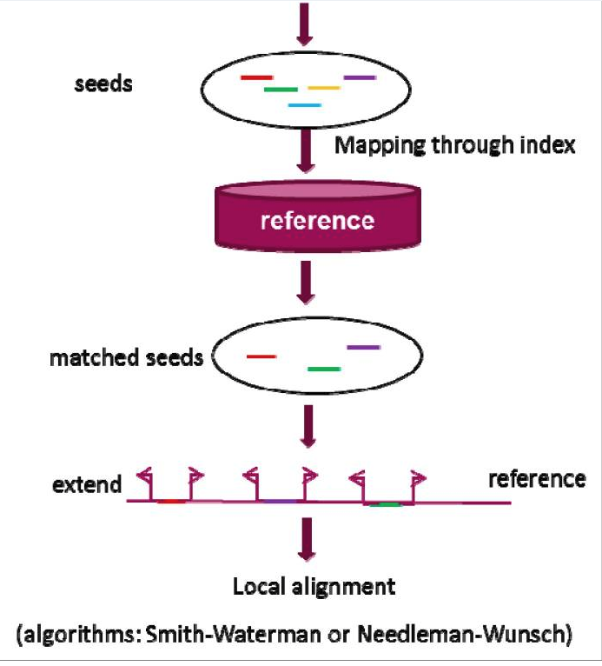
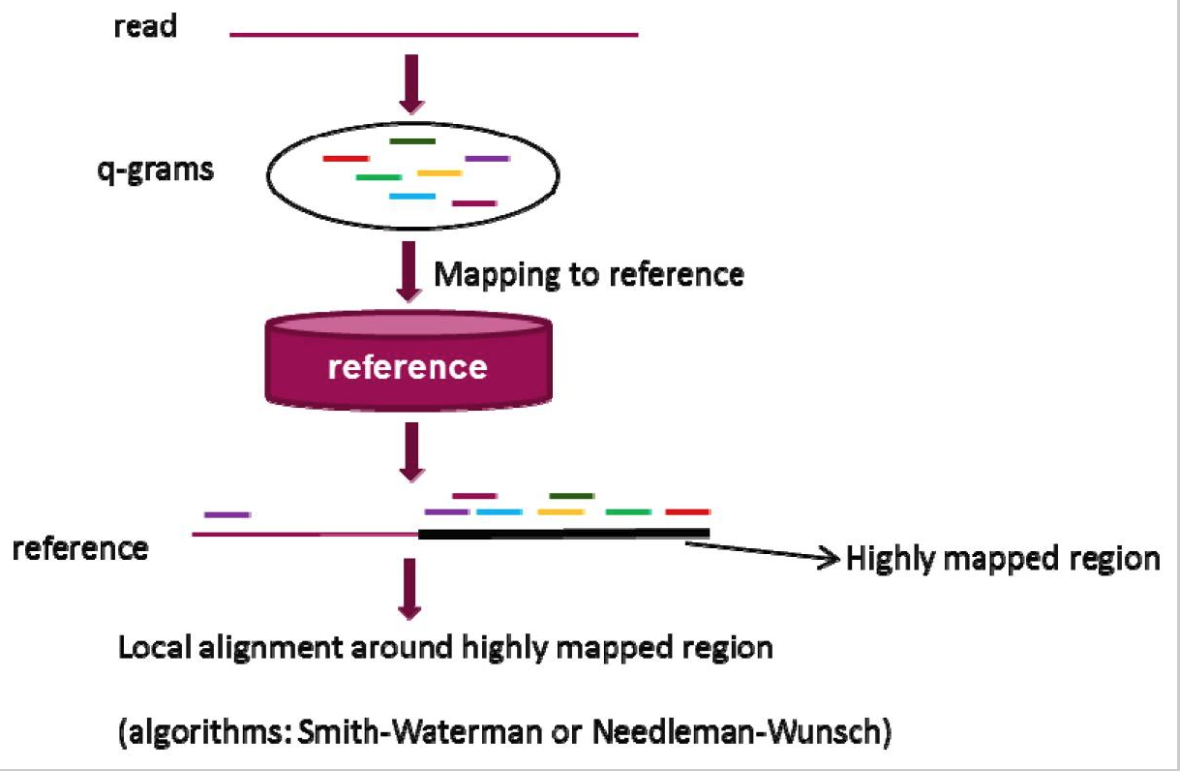
Reference-based Alignment using Seeds
Seed-and-Extend Strategy
Q-gram Filter
Notes:
We found two example methods using Reference-based Alignment using Seeds which are Seed- and extend strategy, and Q-gram filter.
The Seed- and extend strategy, generates a raw seed from a read, identifies the matching seed, and extends the matching seed to do a local alignment of the Smith-Waterman algorithm.
The Q-Gram filter is a little different, and generates a q-gram from a read, identification of highly mapped regions in a reference sequence through multiple q-grams mapping, and a local alignment of the read with the Smith-Waterman algorithm.

Slide 9

Our Approach/Solution: Seed-and-extend strategy
Seed-and-extend steps:
Generate Raw Seed from a read
Identify the sequence’s seed.
Extend the matched seed.
Perform local alignment.
Here is the pipeline’s flow:
Notes:
For our approach to this solution we will use the Seed-and-extend strategy. As shortly explained before, the general approach is to use these following methods:
ReadInSequences:
Read in the individual sequence reads from a Fasta file.
GenerateSeeds:
We Create a set of Seeds associated with these sequences.
MatchSeedOnReference:
Will search the reference sequences for matching sets of given seeds. Once found, the matched seed will be added to the dictionary.
ExtendMatchedSeeds:
Get the matched seeds and extends them using the reference string.
LocalAlignment:
Now we take these Matched Seeds and create local alignments for each of them, attempting to create a complete sequence of the genome.
After discussing implications, we subdivided these different components to different members of the team.

Slide 10
METHODS

Slide 11
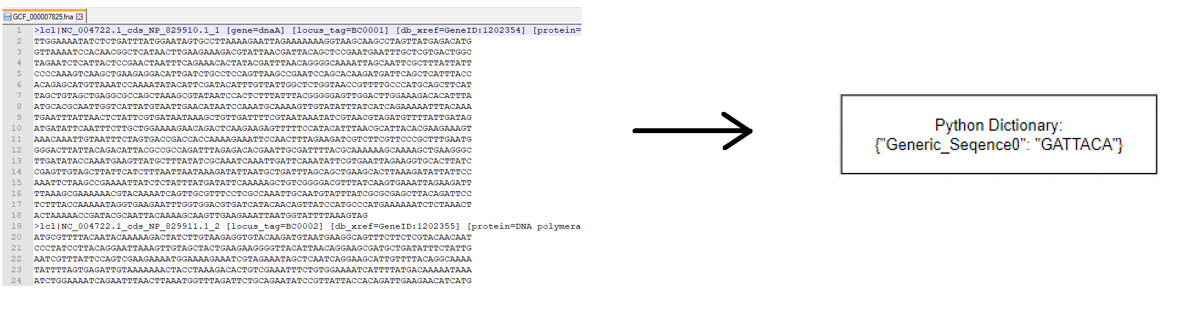
Read Sequences
ReadInSequences()
Take in FASTA “Target” sequence(s), and FASTA “Read” sequence
Python Dictionaries: Utilize Hash functions! -> Constant read/write times.
Notes:
We will Parse these Short Sequences from a FASTA File, and temporarily Store them in a python Dictionary. If you didn't already know, Python Dictionaries are fairly cool because they use a hash function, which allows for a Constant access time, to read and write data.

Slide 12
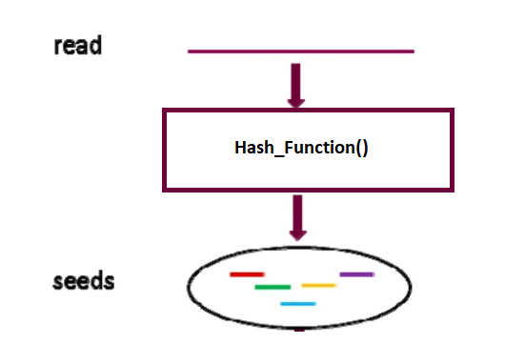
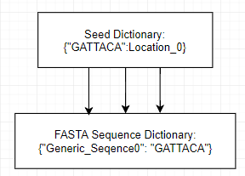
Generate Seeds from Read
GenerateSeeds()
What is a Seed?
Seeds are small portions that match the Read onto the Target Sequence.
Since finding matches on small portions is fast, utilizing seeds is fast!
Its a Tradeoff, while we gain speed, we could lose some accuracy if we miss the “best” alignment.
Notes:
Next we generate references to instances of similar sequences by using a seed function:
This Hash_Function maps to other Seeds with similar sequences, (Hopefully related)
Advantages to using reference seeds:
-It creates a reference of similar sequences.
As discussed earlier in this course:
K-mer matching is like an index in a book, but instead of containing the references of all existing instances of words, it contains the location of each individual instance of a sequence.
There are different ways K-Mer can work:
For example:
-Exact
-Inexact
-Spaced, allows for internal mismatches to occur.
Maximum Exact Match(MEM) seed,
Adaptive Seed,
By using a <> seed to reference sequences we can get a large Speedup when looking up similar sequences, as this reference can be used with the Python Dictionary to reduce reference time to a constant BigO of (1).

Slide 13
Generate Seeds from Read
GenerateSeeds()
Types of Seed Selection: Consider string “ACTTAG”
K-mer Exact / Inexact Seed match:
Exact means “exactly” that, it must have the sub-string within. (TTAG)
Inexact means some flexibility, we could have indels/mismatches (TAAG)
K-mer Spaced Seed
Spaces were we are/are not allowed to mismatch. “10100”, where 1 = must match 0 = can mismatch
Notes:
Next we generate references to instances of similar sequences by using a seed function:
This Hash_Function maps to other Seeds with similar sequences, (Hopefully related)
Advantages to using reference seeds:
-It creates a reference of similar sequences.
As discussed earlier in this course:
K-mer matching is like an index in a book, but instead of containing the references of all existing instances of words, it contains the location of each individual instance of a sequence.
There are different ways K-Mer can work:
For example:
-Exact
-Inexact
-Spaced, allows for internal mismatches to occur.
Maximum Exact Match(MEM) seed,
Adaptive Seed,
By using a <> seed to reference sequences we can get a large Speedup when looking up similar sequences, as this reference can be used with the Python Dictionary to reduce reference time to a constant BigO of (1).

Slide 14

Decision: K-mer Exact Matching
K-mer Exact Match Seeding:
A set of short sequences of k bases that are exact matches with a reference string
Default k value of 11-mer seeds, can be increased for higher accuracy / decreased for speed
First utilized in BLAST
Benefits of this Method:
Fast, with a BigO(N)
Easy to implement (Programmers Rejoice!)

Slide 15
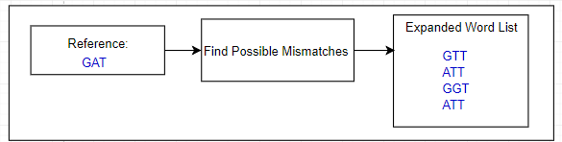
Match Seeds on Reference
MatchSeedOnReference()
Because there are likely to be Errors (Either when Reading or Building the library). We need to account for any Error.
We create an Expanded Word List, from likely Mutations with the smith waterman algorithm and a substitution Matrix.
I Think this is right, but need to double check,
Notes:
Match seeds on reference,
Now that we have a seed dictionary containing
Searching the reference sequence(s) for matching sets of given seeds, once found in sequence, add each to a dictionary of "matched" seeds
Take a Reference sequence, Create a seed, find the likely Mutations of that seed with the (smith waterman algorithm/NeedleMan wunsch) and a substitution Matrix,
> Find the locations of these Likely mutations, And Use smith waterman on it with respect to the reference sequence, to find an extended sequence.
The score between the query and subject is called “High Scoring Pair”

Slide 16
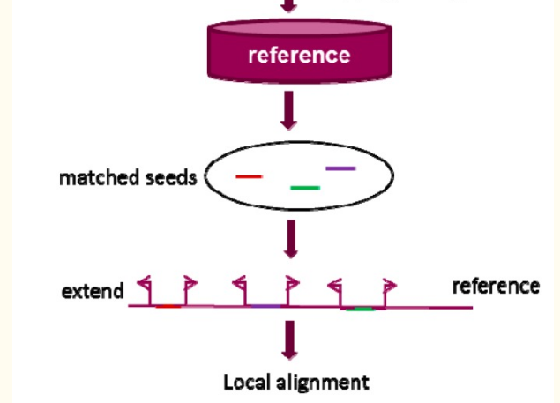
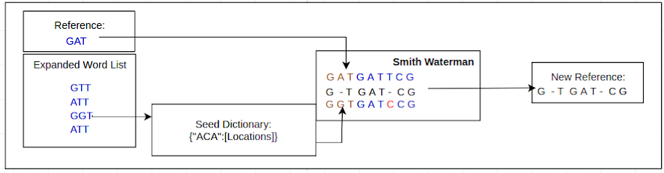
Extend Matched Seeds
ExtendMatchedSeeds()
Get the alignment for every matched seed.
Extend them with the Smith-Waterman algorithm.
Single New Reference genome
Notes:
Extend Matched Seeds, is responsible for utilizing the calculated matched seeds, and extending them along a reference String.

Slide 17
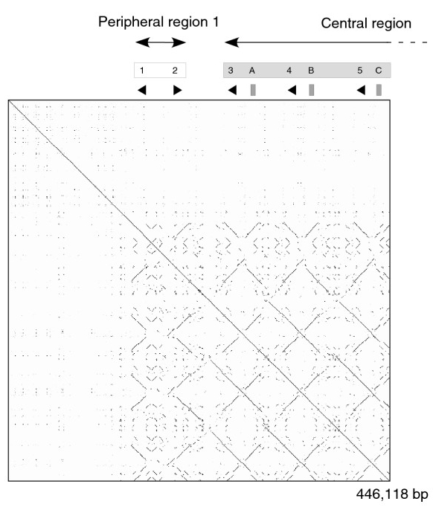
Local Alignment
localAlignment()
Pairwise alignment
Dot-Matrix methods
Dynamic programming:
Smith Waterman
Needleman-Wunsch
Word methods
Progressive, and Iterative Methods.
Notes:
Pairwise comparing two sequences to find alignments
Dot, physical picture local showing comparison
Programming to show how they align
Word, lining up both sequences to compare
And as progressive, and iterative methods improve these pairwise methods by building ‘Family’ trees

Slide 18
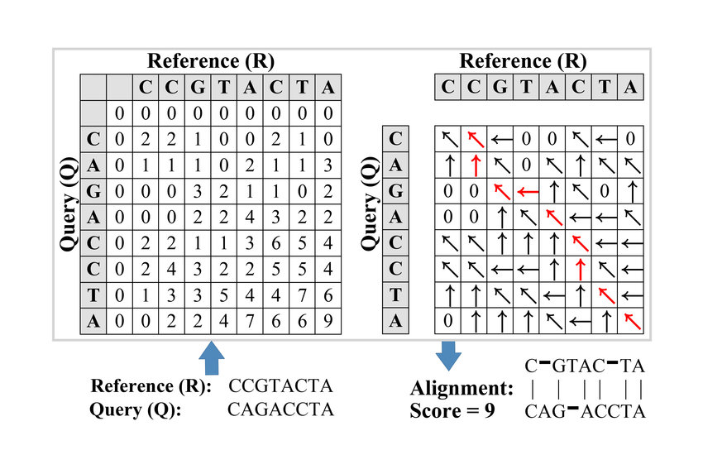
Local Alignment
The final alignment results are generated by the Smith-Waterman modification on the reference sequence.
Steps in Smith-Waterman():
Initialize scoring matrix
Fill out Axis values with
Scoring
Based on: Substitution matrix
Traceback
Use Scoring Matrix to assemble probable matrix.
Notes:
Match-2 Mismatch--1 Gap-1

Slide 19


Our progress
ReadInSequence()
GenerateSeeds()
MatchSeedsOnReference()
ExtendMatchedSeeds()
LocalAlignment()
Testing and Validation
Notes:
So far, we have ReadInSequence(), MatchSeedsOnReference(), ExtendMatchedSeeds(), and LocalAlignment() done for the pipeline. We are still working on the GenerateSeeds() function and we plan to perform software Testing and Validation on our pipeline
If we Finish:
We were able to creating and integrating every method of
Our solution is nothing new, but our project was a good exercise in demonstrating the variety of solutions.
If we don't:
We finished: <>/5 of these parts
Our Progress was limited by our course load, and team communication, as some requirements and functionality were not well described to everyone working on this project.
Describe what went wrong with an individual Method:

Slide 20
Limitations(of our implementation)
Python
Reference-based Alignment programs exist
Predetermined Seeds and SW mismatch/match bonuses
Notes:
There are several limitations for our implementation.
The first one is our implementation is not fast because we were using python,
The Reference-Based Alignment programs already exist, and are often much faster with many options for individual needs in BioInformatics.
And finally, because our Predetermined Seeds and SW mismatch/match bonuses are predetermined, in our current form, users cannot declare their own settings
Our limitations, with our implementation:
Because we were using python, our implementation is not that fast.
Reference-Based Alignment programs already exist, and are often much faster with many options for individual needs in BioInformatics.
And finally, because our Predetermined Seeds and SW mismatch/match bonuses are predetermined, in our current form, users cannot declare their own settings
If we Finish:
Our solution is nothing new, but our project was a good exercise in demonstrating the variety of solutions.
If we don't:
What Did we Learn:
we Learned a lot from this project, as we properly integrated: <Parts>
Finding
would be more equipped to solve in the future.
What could have we done better?

Slide 21
Conclusion
A well structured pipeline
Take in different partial sequences and predict the original sequence.
Reference-based Alignment
Notes:
In conclusion, our pipeline should be able to take in different partial sequences and use Reference-based Alignment method to predict the original sequence.

